Slide 1
WEB DEVELOPMENT & DESIGN FOUNDATIONS WITH HTML5
7TH EDITION
Chapter 7
Key Concepts
Copyright © Terry Felke-Morris

Slide 2
LEARNING
OUTCOMES
In this chapter, you will learn how to ...
Code relative hyperlinks to web pages in folders within a website
Configure a hyperlink to a named fragment internal to a web page
Provide for accessibility by configuring ARIA landmark roles for structural HTML elements
Configure images with CSS sprites
Configure a three-column page layout using CSS
Configure CSS for printing
Describe mobile design best practices
Configure web pages for mobile display using the viewport meta tag
Apply responsive web design techniques with CSS3 media queries and flexible images

Slide 3
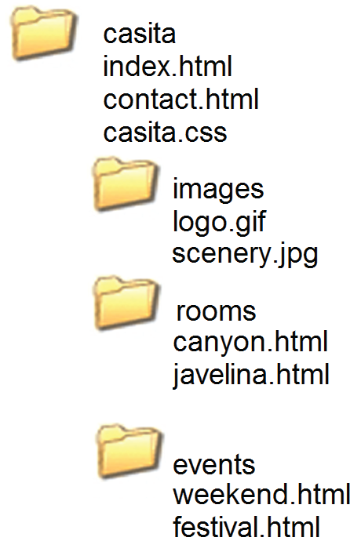
MORE ON
RELATIVE LINKING
Relative links from the Home page: index.html
<a href="contact.html">Contact</a>
<a href="rooms/canyon.html">Canyon</a>
<a href="../index.html">Home</a>
<a href="../events/weekend.html">Weekend</a>
Relative links from the Canyon page:
rooms/canyon.html

Slide 4
HTML LINKING TO FRAGMENT IDENTIFIERS
A link to a part of a web page
Also called named fragments, fragment ids
Two components:
  The element that identifies the named fragment of a web page. This requires the id attribute.
  <div id=“top”> ….. </div>
  2. The anchor tag that links to the named fragment of a web page. This uses the href attribute.
  <a href=“#top”>Back to Top</a>
Note the use of the # in the anchor tag!

Slide 5
LANDMARK ROLES WITH ARIA
Accessible Rich Internet Applications (ARIA)
Landmark Roles
  banner (a header/logo area)
  navigation (a collection of navigation elements)
  main (the main content of a document)
  complementary (a supporting part of the web page document, designed to be complementary to the main content )
  contentinfo (an area that contains information about the content such as copyright )
  form (an area that contains a form)
  search (an area of a web page that provides search functionality)
Example: <header role=“banner”>

Slide 6
OPENING A LINK
IN A NEW BROWSER WINDOW
The target attribute on the anchor element opens a link in a new browser window or new browser tab.
<a href="http://yahoo.com" target="_blank">Yahoo!</a>

Slide 7
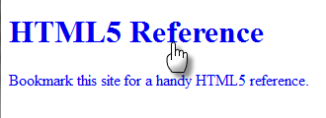
HTML5 BLOCK ANCHOR
Configure block display elements within a hyperlink
<a href="http://www.w3.org/TR/html-markup">
<h1>HTML5 Reference</h1>
<p>Bookmark this site for a handy HTML5 reference.</p>
</a>

Slide 8
TELEPHONE & TEXT MESSAGE HYPERLINKS
Telephone Scheme
<a href="tel:888-555-5555">Call 888-555-5555</a>
Many mobile browsers will initiate a phone call when the hyperlink is clicked.
SMS Scheme
<a href="sms:888-555-5555">Text 888-555-5555</a>
Many mobile browsers will initiate a text message to the phone number when the hyperlink is clicked.

Slide 9
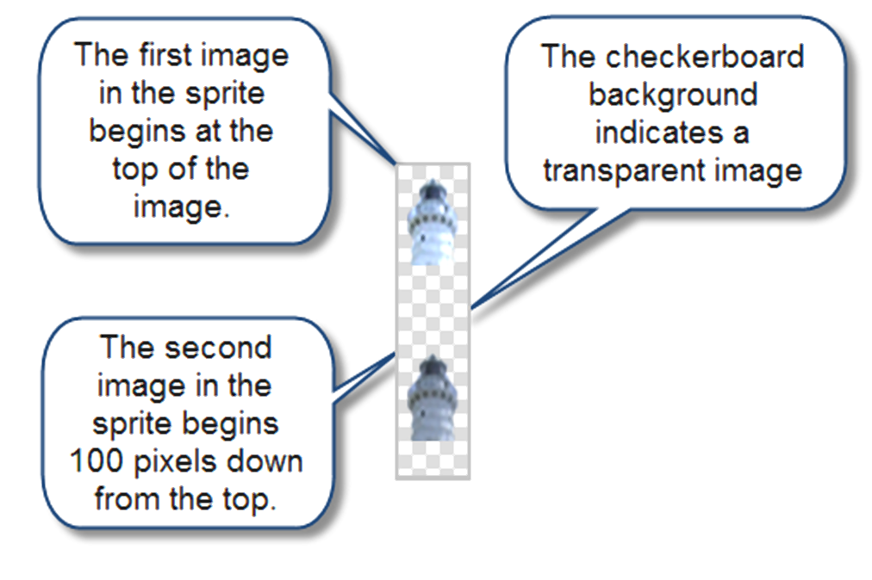
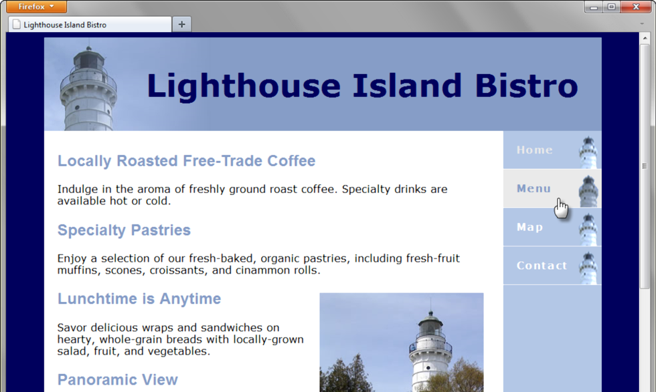
CSS SPRITES
Sprite
  an image file that contains multiple small graphics
  advantage: saves download time

Slide 10
CHECKPOINT
Describe a reason to organize the files in a website using folders and subfolders.
Which attribute configures a hyperlink to open the file in a new browser window or tab?
State an advantage of using CSS sprites in a website.

Slide 11
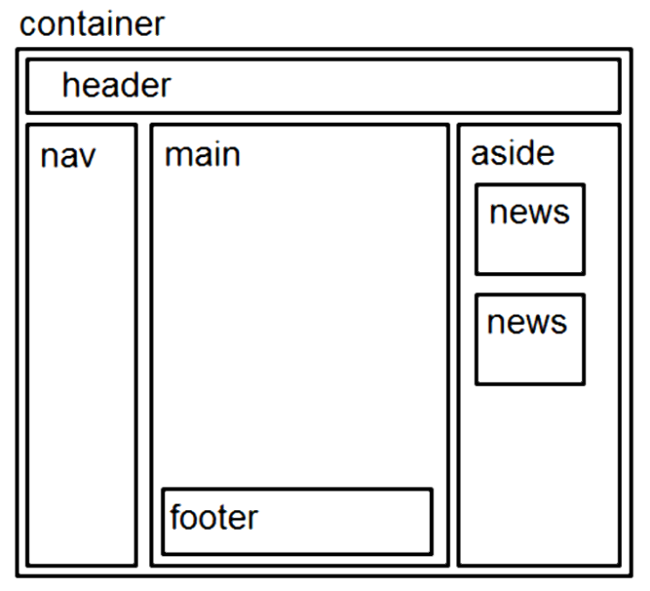
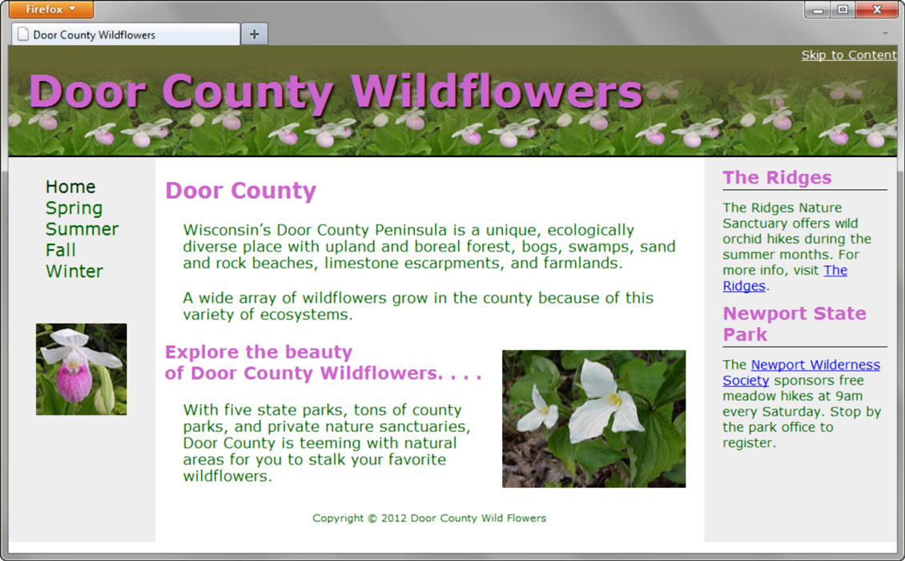
THREE COLUMN
PAGE LAYOUT
A common web page layout consists of a header across the top of the page with three columns below:
navigation, content, and sidebar.

Slide 12


THREE COLUMN
LAYOUT
container sets default background color, text color, font typeface, and a minimum width
Left-column navigation
  float: left; width:150px;
Right-column content
  float: right; width: 200px;
Center column
  Uses the remaining screen room available room after the floating columns display
  margin: 0 210px 0 160px;
Footer – clears the float
  clear: both;

Slide 13
CSS STYLING FOR PRINT
Create an external style sheet with the configurations for browser display.
Create a second external style sheet with the configurations for printing.
Connect both of the external style sheets to the web page using two <link > elements.
<link rel="stylesheet" href="wildflower.css" type="text/css" media="screen">
<link rel="stylesheet" href="wildflowerprint.css" type="text/css" media="print">

Slide 14
PRINT STYLING BEST PRACTICES
Hide non-essential content
Example:
  #nav { display: none; }
Configure font size and color for printing
  Use pt font sizes, use dark text color
Control page breaks
  Example:
  .newpage { page-break-before: always; }
Print URLs for hyperlinks
Example:
  #sidebar a:after { content: " (" attr(href) ") "; }

Slide 15
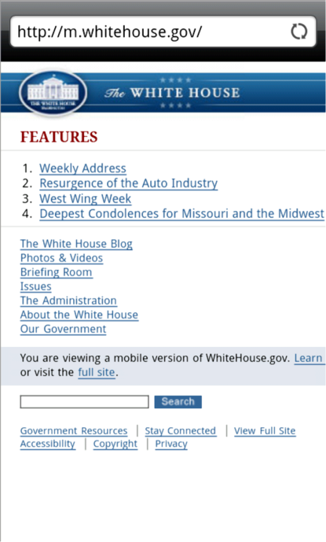
MOBILE WEB LIMITATIONS
Small Screen Size
Low bandwidth
Limited fonts
Limited color
Awkward controls
Lack of Flash support
Limited processor and memory
Cost per kilobyte

Slide 16
MOBILE WEB DESIGN BEST PRACTICES
Recommended by the W3C
  http://www.w3.org/TR/mobile-bp
  http://www.w3.org/2007/02/mwbp_flip_cards.html
Optimize Layout, Navigation, Graphics, and Text for Mobile Use
Design for One Web

Slide 17
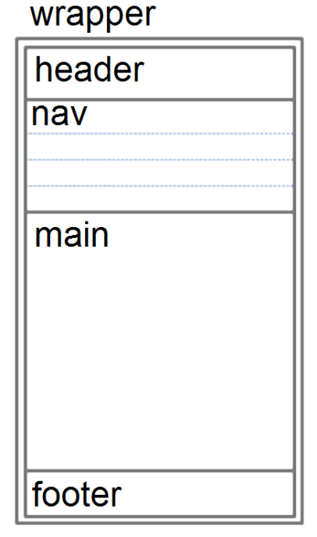
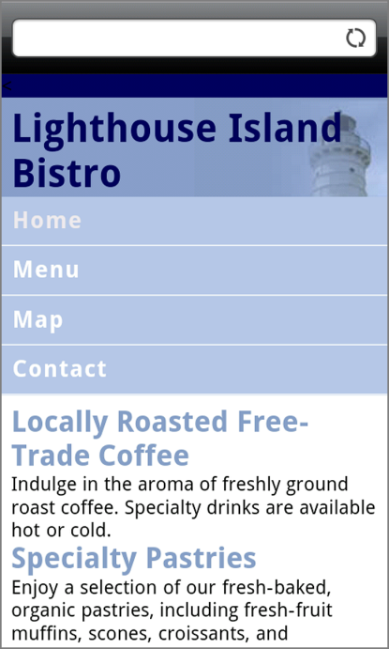
OPTIMIZE LAYOUT FOR MOBILE USE
Single column design
Limit scrolling to one direction
Use heading elements
Use lists
Avoid using tables
Provide labels for form controls
Avoid using pixel units in style sheets
Avoid absolute positioning in style sheets
Hide content that is not essential for mobile use.

Slide 18
OPTIMIZE NAVIGATION FOR MOBILE USE
Provide minimal navigation near the top of the page
Provide consistent navigation
Avoid hyperlinks that open files in new windows or pop-up windows
Try to balance both the number of hyperlinks on a page and the number of levels needed to access information

Slide 19
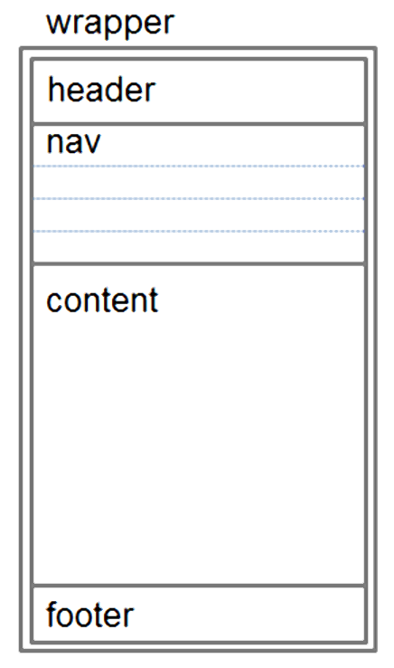
OPTIMIZE GRAPHICS FOR MOBILE USE
Avoid displaying images that are wider than the screen width
Configure alternate, small optimized background images
Some mobile browsers will downsize all images, so avoid using images that contain text
Avoid the use of large graphic images
Specify the size of images
Provide alternate text for graphics and other non-text elements.

Slide 20
OPTIMIZE TEXT FOR MOBILE USE
Configure good contrast between text and background colors
Use common font typefaces
Configure font size with em units or percentages
Use a short, descriptive page title

Slide 21
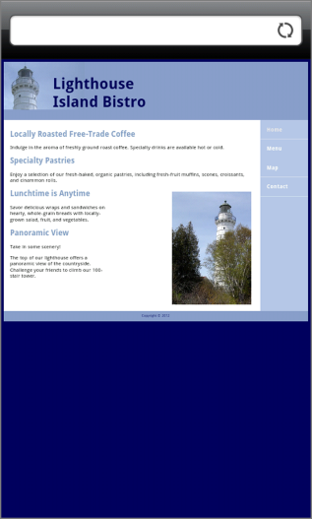
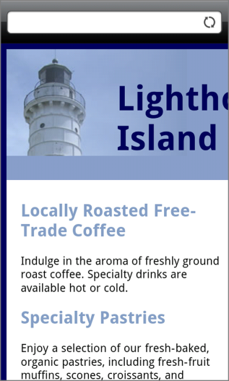
VIEWPORT META TAG
Default action for most mobile devices
is to zoom out and scale the web page
Viewport Meta Tag
Created as an Apple extension to configure
display on mobile devices
Configures width and initial scale of browser viewport
<meta name="viewport" content="width=device-width, initial-scale=1.0">

Slide 22
CSS3 MEDIA QUERIES
Media Query
  Determines the capability of the mobile device, such as screen resolution
  Directs the browser to styles configured specifically for those capabilities
Example with link tag
<link href="lighthousemobile.css" rel="stylesheet"
media="only all and (max-device-width: 480px)">
Example within CSS
    @media only all and (max-width: 768px) {
    }

Slide 23
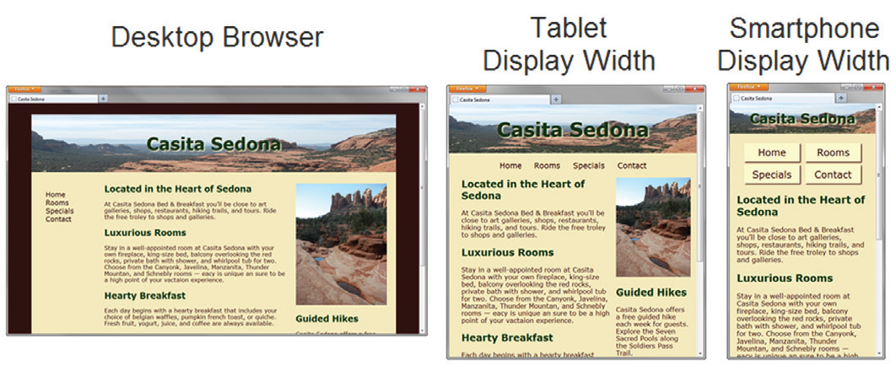
FLEXIBLE IMAGES
Edit HTML:
remove height and width attributes
CSS:
  img { max-width: 100%;
  height: auto; }

Slide 24
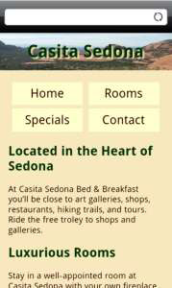
TESTING MOBILE DISPLAY OPTIONS
Test with a mobile device
Emulators
  Opera Mobile Emulator
  Mobilizer
  Opera Mini Simulator
  iPhone Emulator
Test with a Desktop Browser
Install an iOS or Android SDK

Slide 25
CSS FLEXIBLE BOX LAYOUT MODULE
Referred to as “flexbox”
GREAT way to easily configure multi-column page layout
elements contained within a flex container can be configured either horizontally or vertically in a flexible manner with flexible sizing
Flexbox is not yet well-supported by browsers.
Check http://caniuse.com/flexbox for the current level of browser support.
Common Properties used with flexbox:
    display flex
    flex-direction order
    flex-wrap
    justify-content

Slide 26
USING FLEXBOX
Configure a flexible container “flex container”
Configure the direction of the flex
Example:
      #demo { display: -webkit-flex;
      display: flex;
      -webkit-flex-direction: row;
      flex-direction: row; }
Adjust the proportion of the “flex item” elements in the container
Example:
      nav { -webkit-flex: 1; flex: 1; }
      main { -webkit-flex: 7; flex:7; }
      aside { -webkit-flex:2; flex: 2 }

Slide 27
CSS DEBUGGING TIPS
Manually check syntax errors
Use W3C CSS Validator to check syntax errors
  http://jigsaw.w3.org/css-validator/
Configure temporary background colors
Configure temporary borders
Use CSS comments to find the unexpected
  /* the browser ignores this code */
Don’t expect your pages to look exactly the same in all browsers!
Be patient!

Slide 28
CHECKPOINT
Describe a design consideration when configuring a web page for mobile display.
True of False. The media="handheld" attribute reliably targets mobile devices.

Slide 29
SUMMARY
This chapter introduced you to a variety of topics related to hyperlinks, page layout, and designing for the mobile web.

